Slide 1
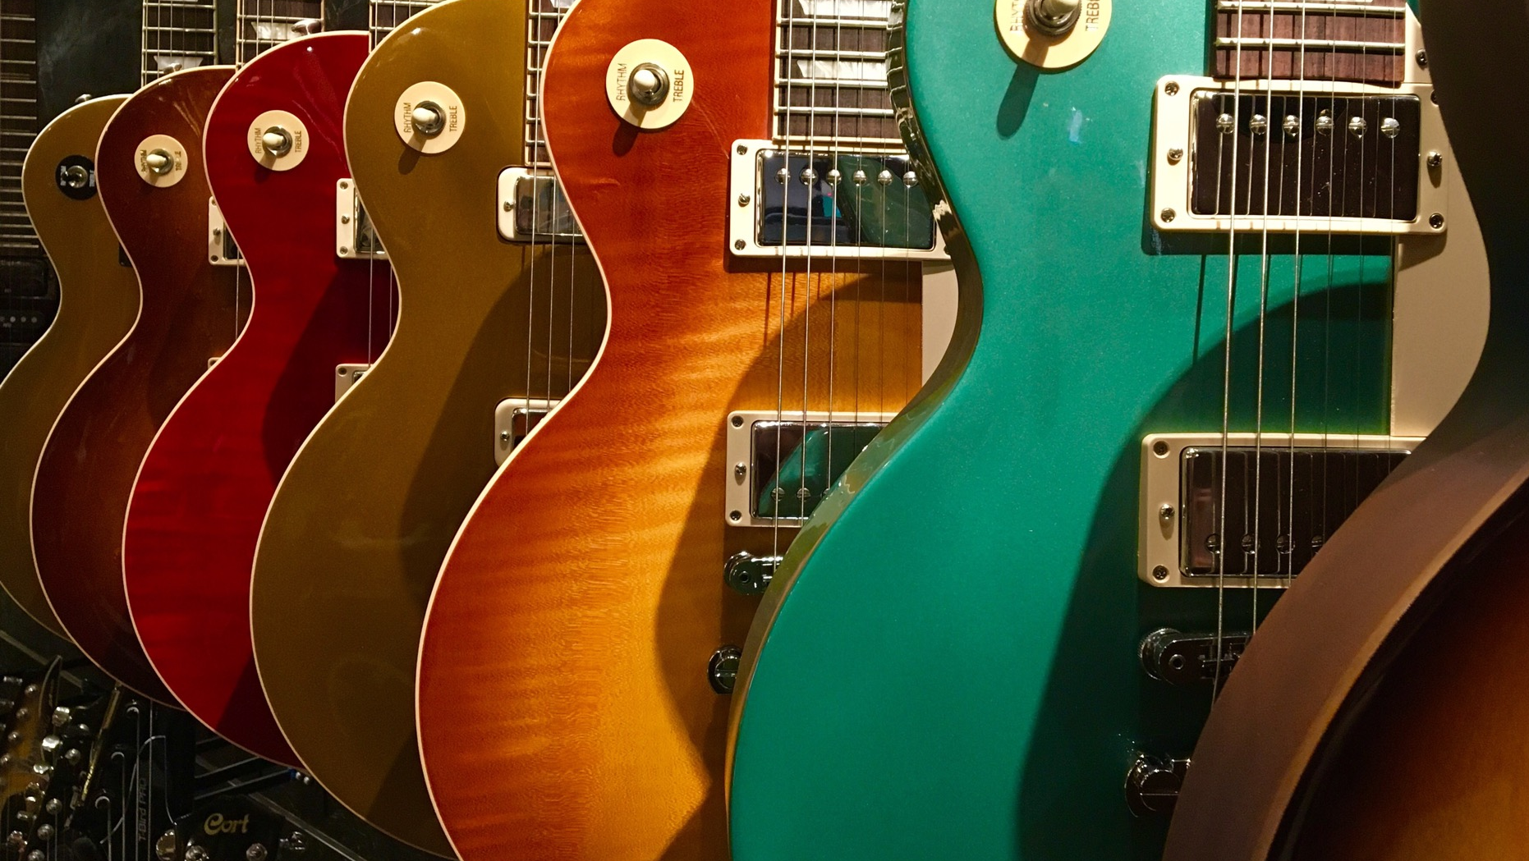
In Search of The Forth Chord
Software Architecture for the Rest of Us

Slide 2
Introduction
Software architecture is a complex topic
There are some repeatable patterns
Every system does not need to be (and should not be) a unicorn that only you understand

Slide 3
What is Software Architecture?
Non-functional requirements
Documentation
Politics
Testing
Notes:
Non-functional requirements – Software speed, reliability, scale, speed to market
Documentation – ADRs, where are the docs, what is documented and how? Who is responsible
Politics – Can’t just ask which NFRs you want

Slide 4
Who is a software architect?
In the absence of an explicit software architecture, the person that is writing the code is the architect

Slide 5
What problems are we trying to solve
Software Speed
Responsive / latency
Throughput
Capacity
Scale
Concurrency
State
Reliable
Usable
Availability
Secure
Speed to Market
Maintainable
Portable
Flexible
Extensible
Supportable
Deployable
Testable

Slide 6
What problems are we trying to solve?
Software Speed – you want you program to run quickly
Scale – you want your software to accommodate many users
Reliability – you want your software to be reliable
Speed to Market
How quick? What does quick mean?
How many?
What’s an acceptable downtime? Cost of unavailability
Timeframe
Notes:
99.9% uptime = 44 minutes downtime per month
99.99% uptime = 4.38 minutes downtime per month

Slide 7
Speed
Benchmark – how fast do you need and why
What needs to be fast – does the system really need to be fast, or just responsive?
Efficient
Responsive
Usable
Operable

Slide 8
Scale
What kind of scale are we talking – users and percentage
A 1 user system scaling to a 10 user system is an increase of 1000%
A 1,000 user system scaling to a 5,000 user system is an increase of 500%
Is the scale in peaks (e.g. Black Friday)
Available

Slide 9
Reliable
What do we mean by reliable?
Is available and usable
Has no faults
Secure
Is it also
Supportable and supported
Tested (all software is tested)
Integrity
Accuracy
Fault tolerant
Recoverable
Stable
Usable
Testable
Observable
Supportable

Slide 10
Time to Market
Deployable
Software must be easily deployed
Flexible
Must be easy to make changes
Compliant
Deployable
Composable
Interoperable
Easily Testable
Notes:
All software is testable – it’s just who tests it

Slide 11

Decision Time
What characteristics are important to the successful use of the system
Who can make that decision
Once a decision has been made – it should be documented
ADR

Slide 12

Three Chords

Slide 13
Using an Event Broker
Event Driven Systems
Microservices

Slide 14

Demo – Azure Service Bus

Slide 15
Store the Event History of the System
Event Sourcing

Slide 16
Demo – Raven?

Slide 17
Separate Writes and Reads
CQRS

Slide 18
Caching

